Slide 1
Coffee Shop

Slide 2
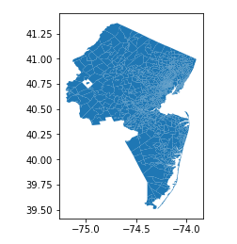
NJTPA provides data on areas serviced by NJ transit
NJTPA provides both shape files, current and forecasted population and employment statistics
Data available here:
https://www.njtpa.org/data-maps/data-maps+

Slide 3
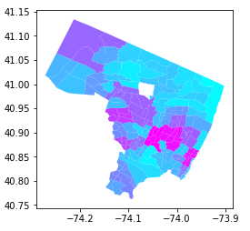
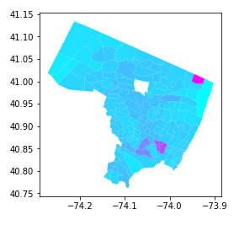
Population is really centered in the Southeastern region of the County
Bergen County 2015 Population
Bergen County Forecasted Population Growth

Slide 4
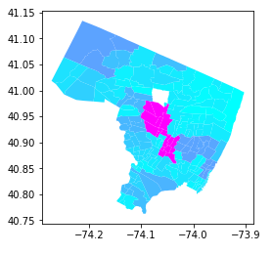
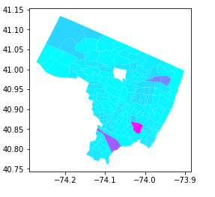
Employment is really centralized to a small area
Bergen County 2015 Employment
Bergen County Forecasted Employment Growth

Slide 5
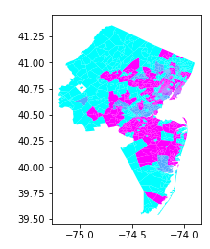
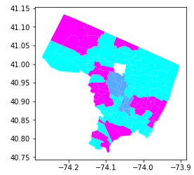
Clustering we see the east of the state is different from the West and in Bergen the are with highest employment is seen as a unique Cluster
NJ Clusters on Employment & Population (Including Forecasts)
Bergen Clusters on Employment & Population (Including Forecasts)

Slide 6
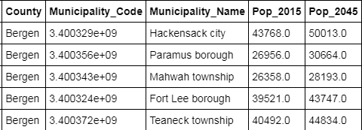
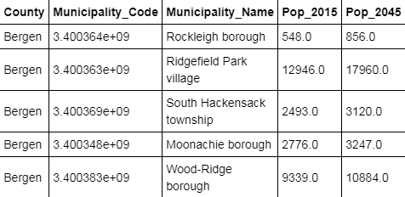
Hackensack is the largest Municipality and while on a % basis sees slower growth, on an absolute basis they still see more growth than Ridgefield
Top 5 Municipalities for 2015 Population
Top Five Municipalities for Population Growth

Slide 7


Types of Businesses Near Hackensack and Ridgefield Park
Hackensack Venues
Ridgefield Park Venues

Slide 8
Conclusion
Based on the Size and Economic Activity, Hackensack & Ridgefield park offer good opportunities
Due to larger amounts of existing competition in Ridgefield Park, Hackensack is the best Municipality to open a new coffee shop targeting morning commuters in Bergen County

